Slide 1
Project 1: Final Presentation
Kayla Robledo
March 2nd, 2026

Slide 2
Research Questions
From baseline to year 2 after starting highly active antiretroviral treatment (HAART)...
Is there a difference in viral load counts between those who use hard drugs at baseline and those who do not?
Is there a difference in CD4+ T cell counts between those who use hard drugs at baseline and those who do not?
Is there a difference in physical quality-of-life scores between those who use hard drugs at baseline and those who do not?
Is there a difference in mental quality-of-life scores between those who use hard drugs at baseline and those who do not?
Can differences in these outcomes by baseline drug use could be explained by adherence at year 2?

Slide 3
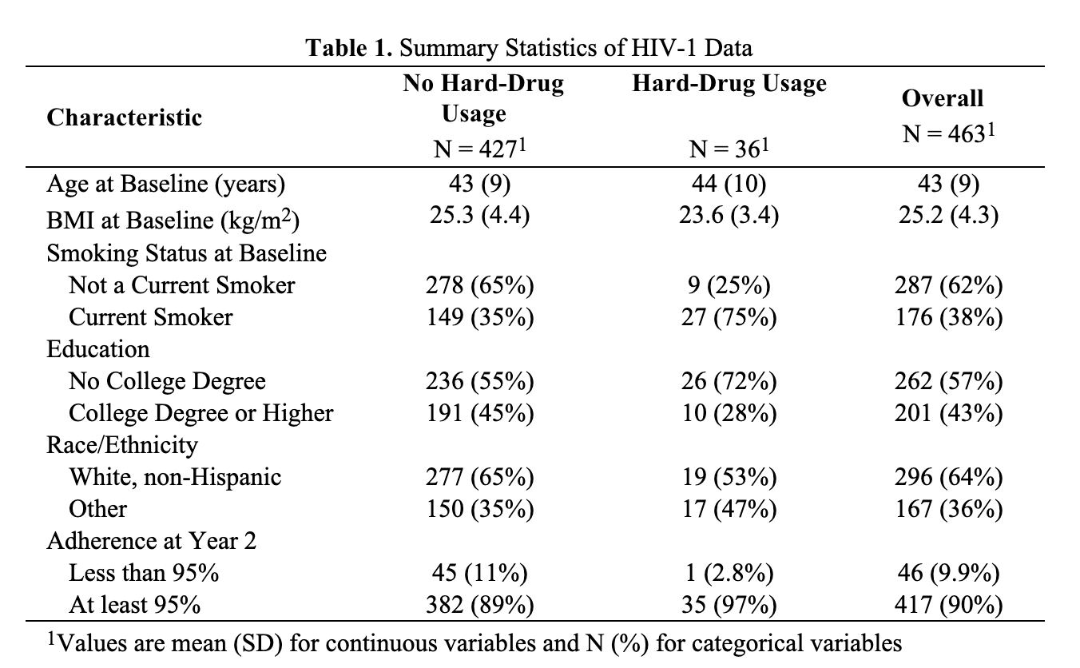
Data Overview
715 participants → 463 participants
Excluded data to those who had all 4 outcomes at baseline at year 2
Excluded those with BMI values below 0 kg/m² and above 250 kg/m²
grouped: education (no college vs. college or higher), smoking (current vs. not), race (white, non-Hispanic vs. other), and year 2 adherence (<95% vs. ≥95%)

Slide 4
Analysis
4 different linear models:
Outcomes: log₁₀(viral load), CD4+ T cell counts, physical quality-of-life, mental-quality-of-life
Primary explanatory variable: baseline hard drug usage
Covariates: baseline outcome, age, BMI, smoking status, race/ethnicity, adherence, education
One conventional (frequentist) model for each outcome
Report: point estimates, 95% confidence intervals, p-values
One Bayesian model for each outcome
Non-informative priors for regression parameters
Intercept ~ Normal(1, 10000)
Coefficients ~ Normal(0, 10000)
Residual standard deviation ~ Half-Normal(0, 10000)
Report: posterior means, 95% credible intervals, posterior probabilities
Evidence of a statistical association would be determined by a p-value < 0.05 or the respective 95% intervals excluding 0
Clinically meaningful differences:
Viral load: 0.5 log₁₀ change
CD4: 50 cells count change
Quality-of-life: 2-point change
One additional Bayesian linear model without controlling for adherence to see if posterior means, 95% CrIs and posterior probabilities change

Slide 5
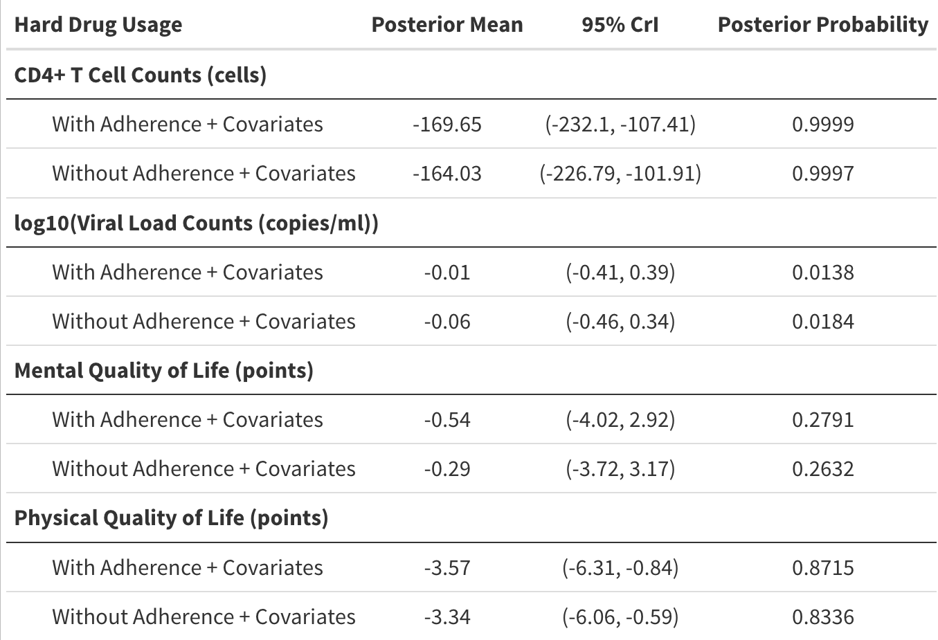
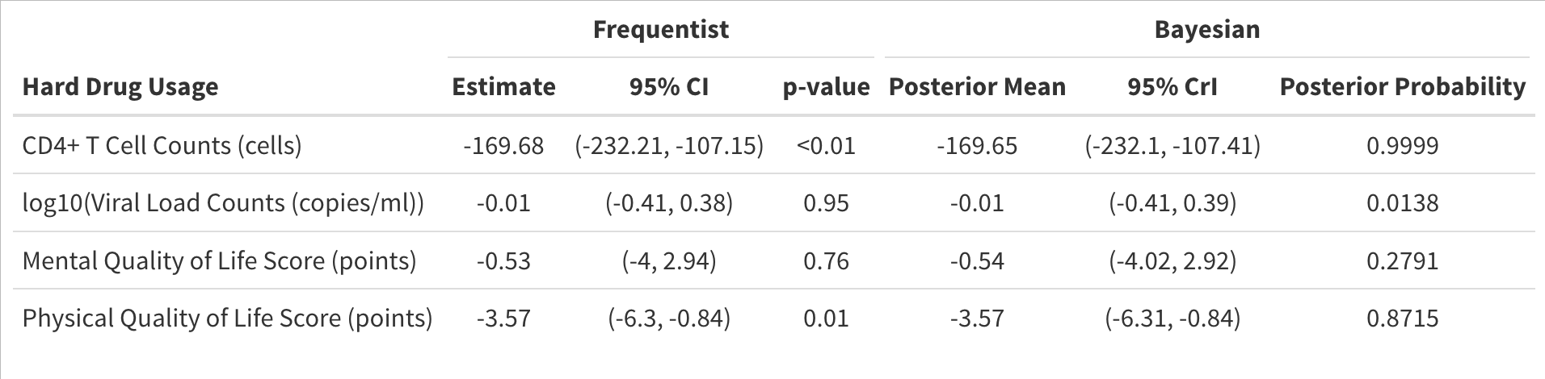
Results

Slide 6
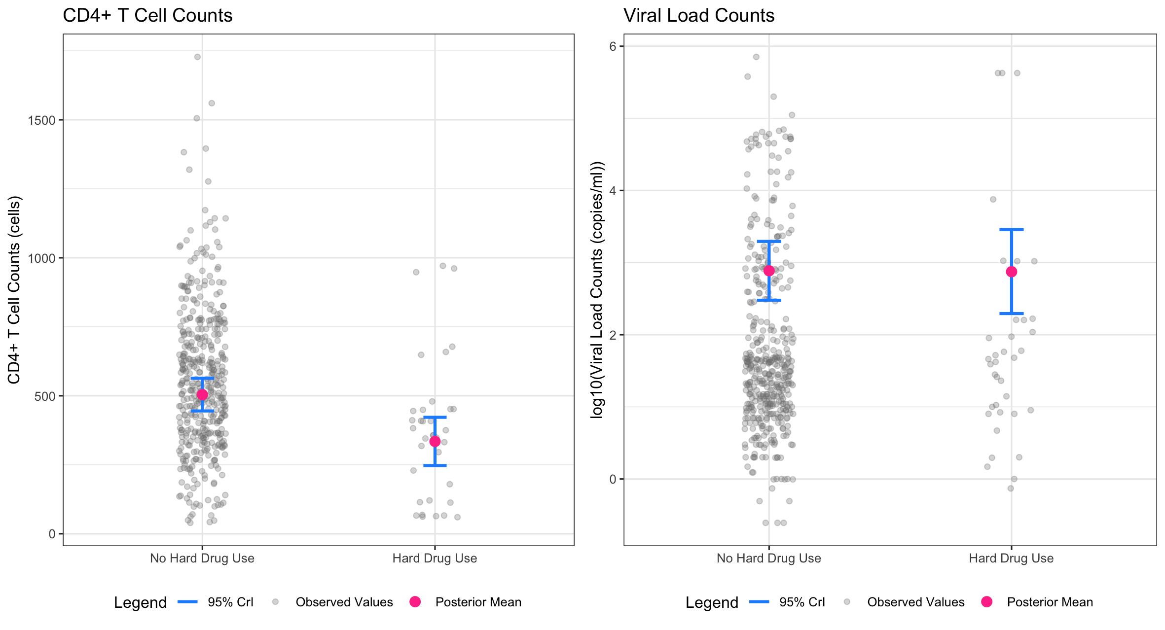
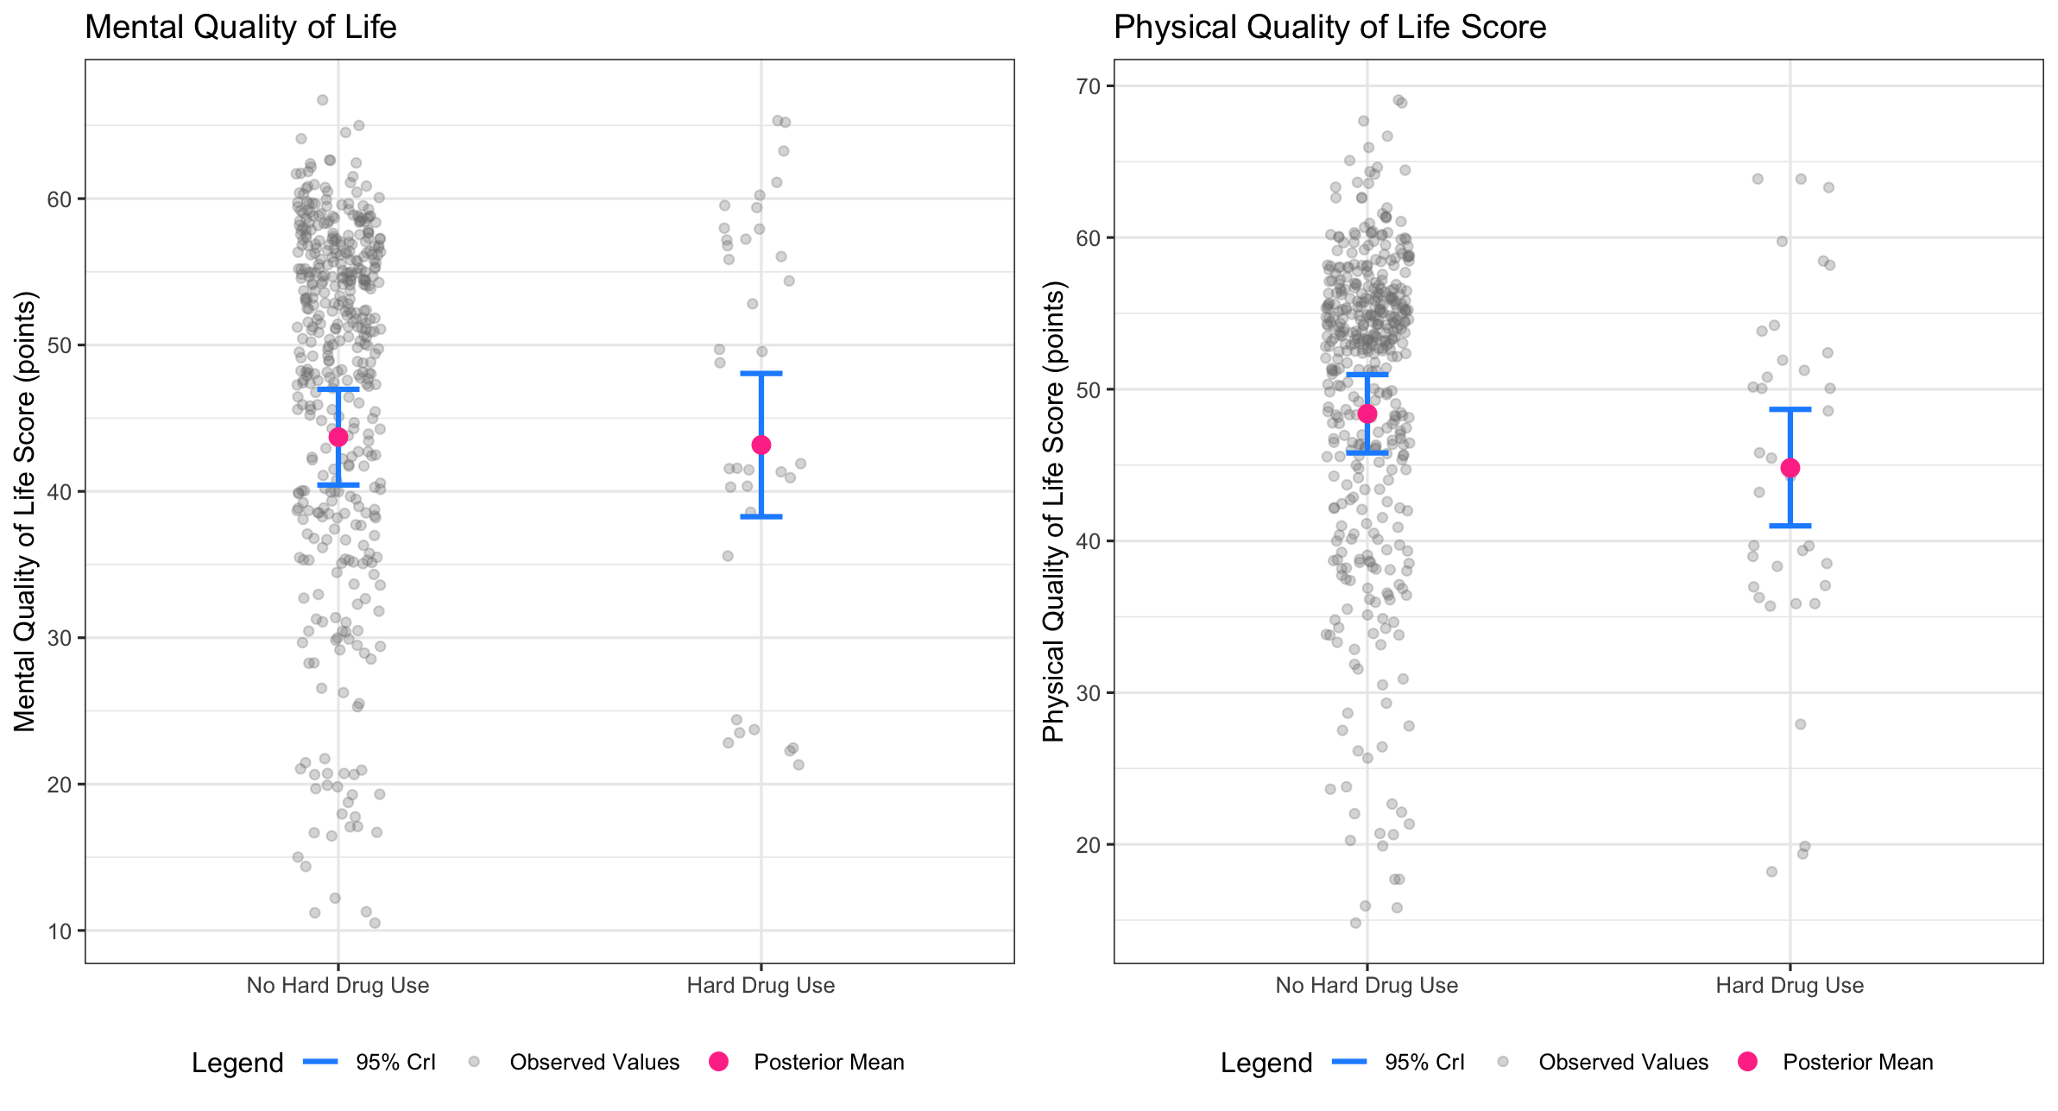
Clinical Outcomes
Quality-of-Life Outcomes

Slide 7
Discussion
Baseline hard drug use was linked to declines in CD4+ T cell counts and physical quality of life both statistically and clinically
Viral load and mental quality of life showed no significant changes
Including adherence in models did not alter results; most participants had ≥95% adherence at year 2
Mild nonnormality and heteroscedasticity observed; results should be interpreted cautiously
Analysis included only complete cases, reducing sample size and potentially biasing results
Self-reported drug use may have introduced misclassification bias
Other unmeasured factors (continued drug use, mental health, comorbidities) may have influenced outcomes
Wide variability present across outcomes

Slide 8
Questions?

